Slide 1

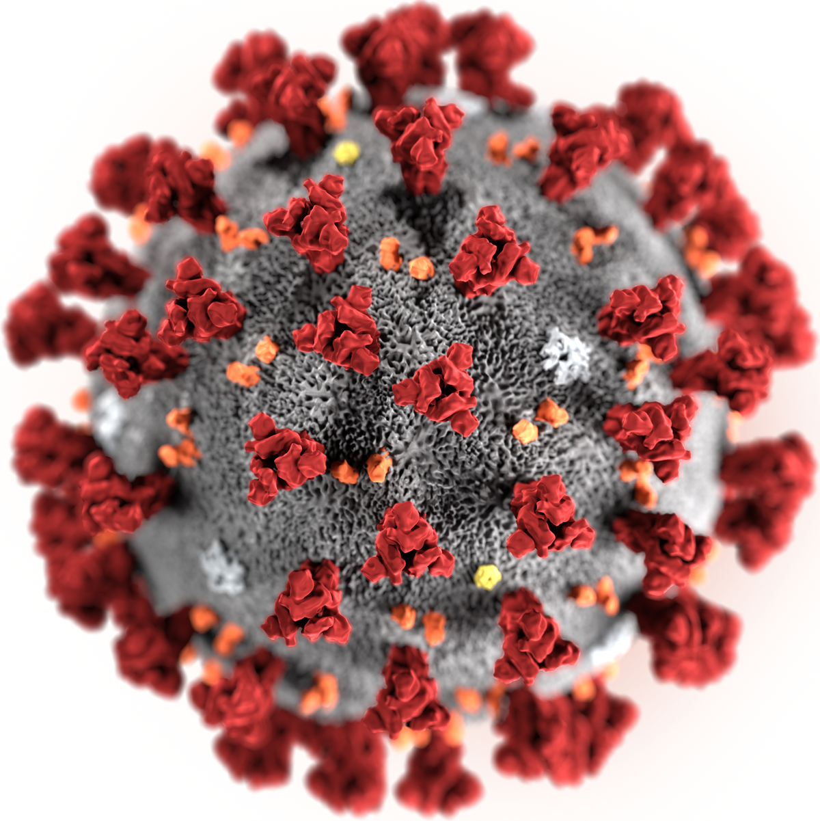
Congresswoman Terri A. Sewell :
Hosts
SBA COVID-19 Assistance for Small Businesses Webinar
This Photo by Unknown Author is licensed under CC BY-SA

Slide 2
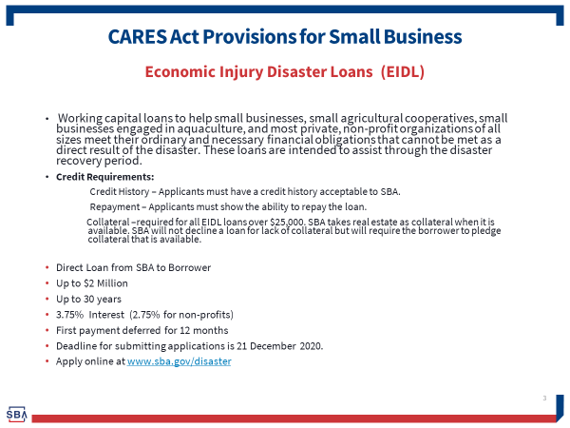

Slide 3
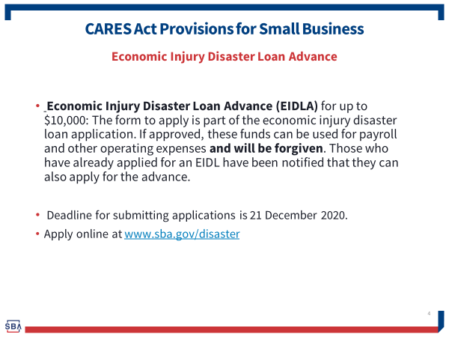

Slide 4
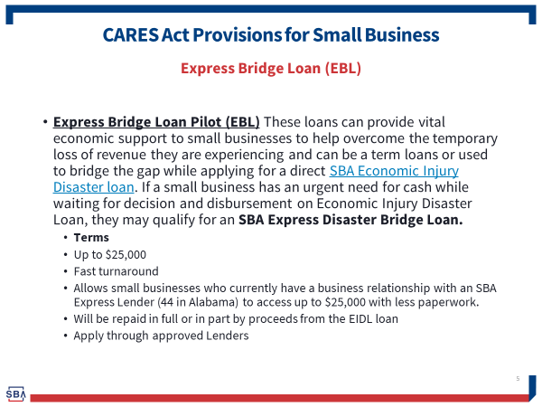

Slide 5
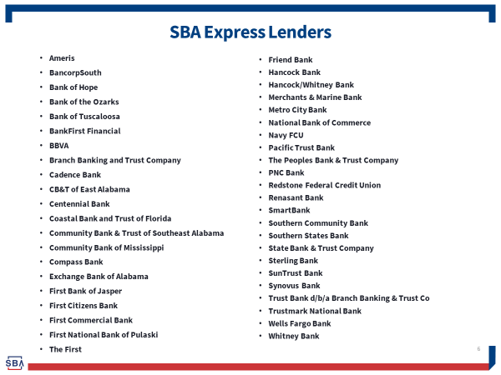

Slide 6
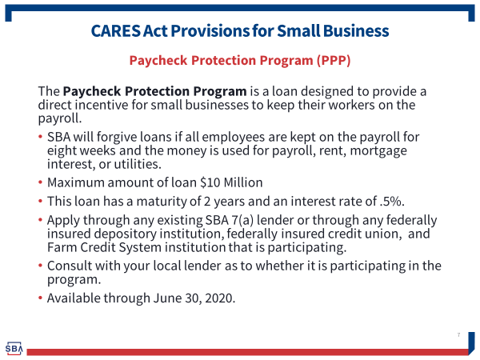

Slide 7
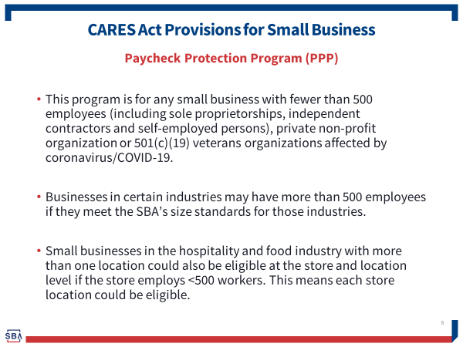

Slide 8
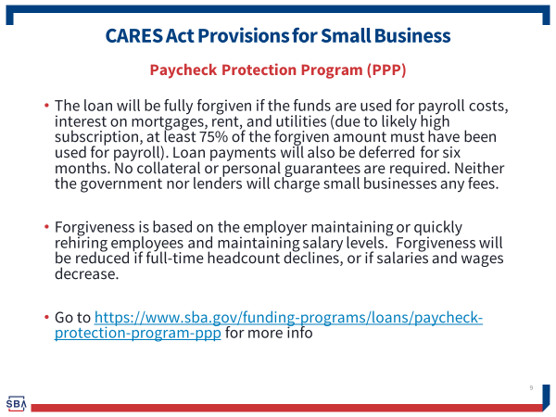

Slide 9
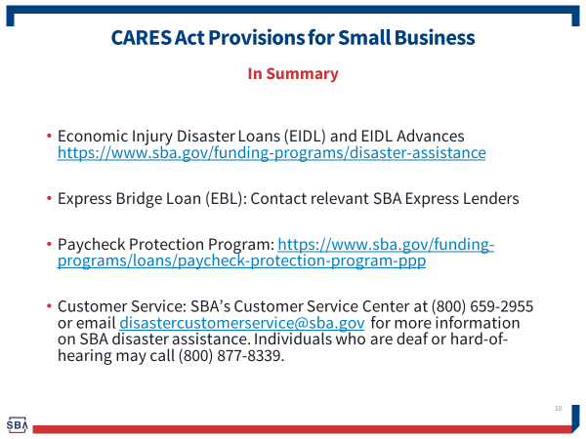

Slide 10
Alabama Small Business Development Center Network Presentation
COVID-19 Assistance for Small Businesses

Slide 11
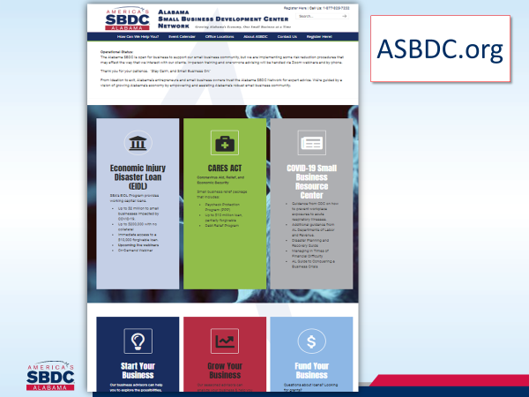

Slide 12
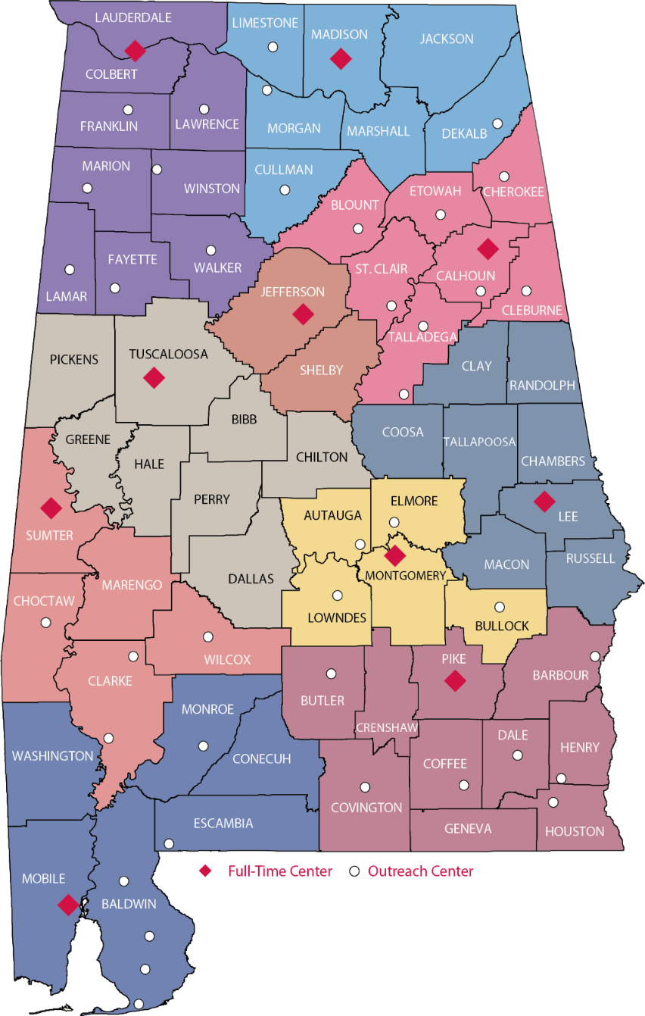









Alabama SBDC Network
10 Full-Time Service Centers, 40 Outreach Locations
Notes:
10 Full Time location, primarily at 4yr institutions,
40 outreach locations: not full time, but frequent visit with local partner, such as chambers, incubators, developers, etc.
Survey

Slide 13
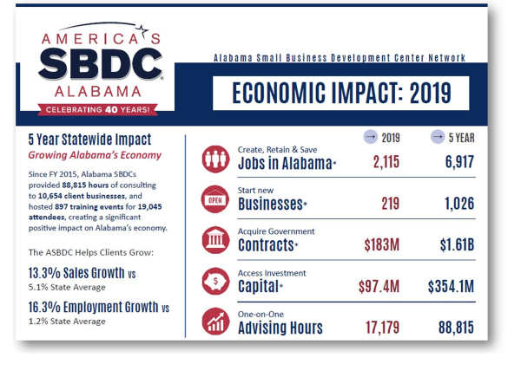

Slide 14


Slide 15
Birmingham Business Alliance Presentation
COVID-19 Assistance for Small Businesses

Slide 16

Key Focus Areas
Life Sciences/
Healthcare
Advanced
Manufacturing
Information
Technology

Slide 17
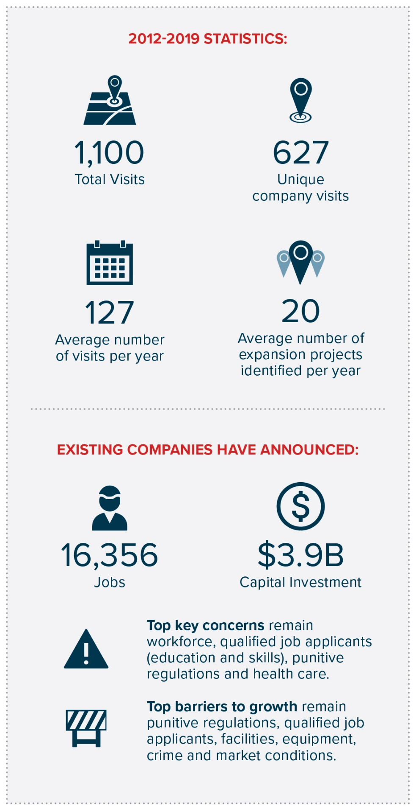
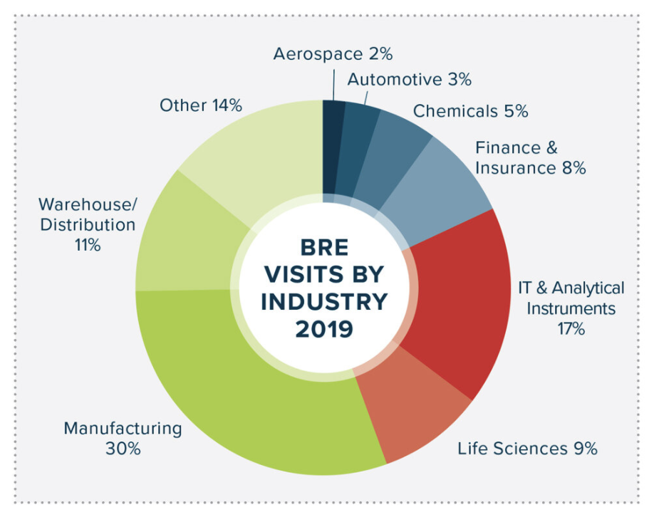
Business Retention & Expansion
Life Sciences/
Healthcare
Advanced
Manufacturing
Information
Technology

Slide 18


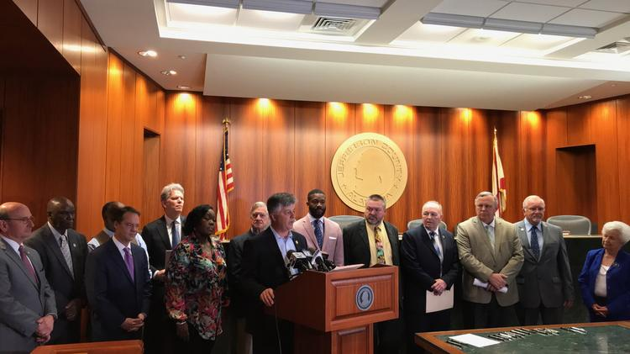


Key Initiatives
Workforce Development & Alignment
Regional Cooperation
Innovative Company Recruitment Practices
Centralizing Information

Slide 19





Healthcare Competitive Advantages

Slide 20
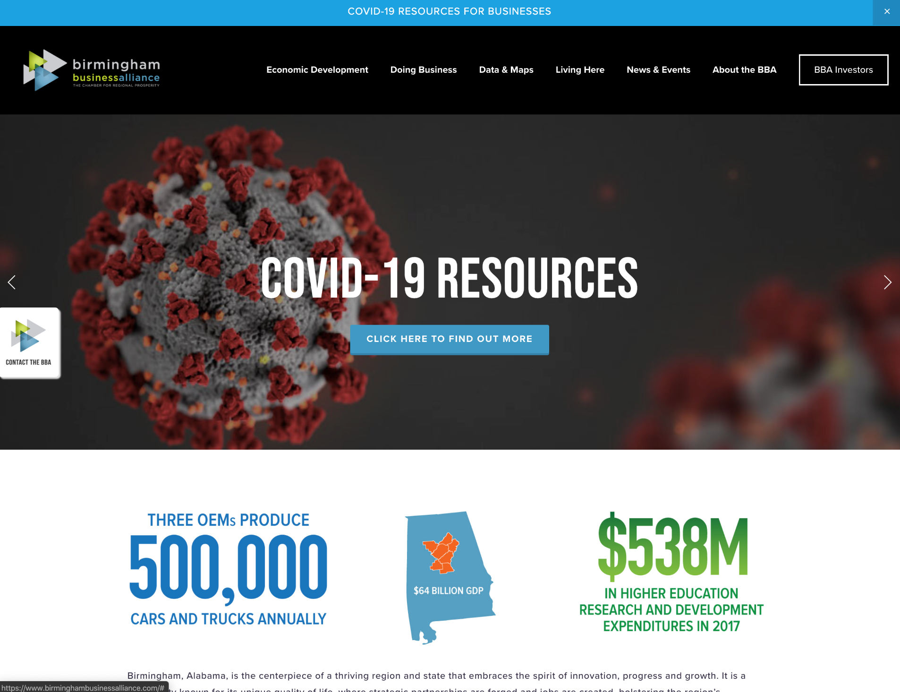
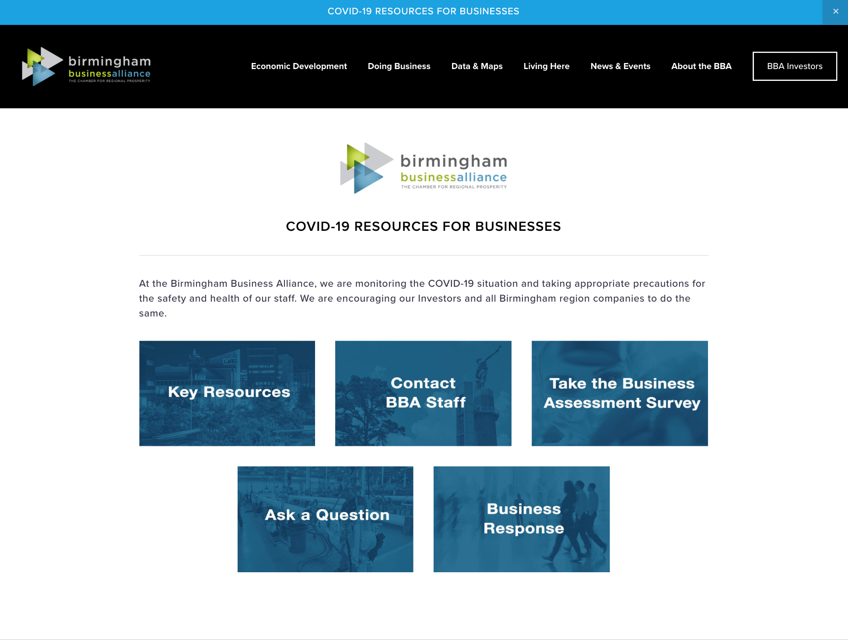
BBA COVID-19 Resources for Businesses

Slide 21
Montgomery Area Chamber of Commerce Presentation
COVID-19 Small Business Coronavirus Aid, Relief, and Economic Security (CARES) Act

Slide 22
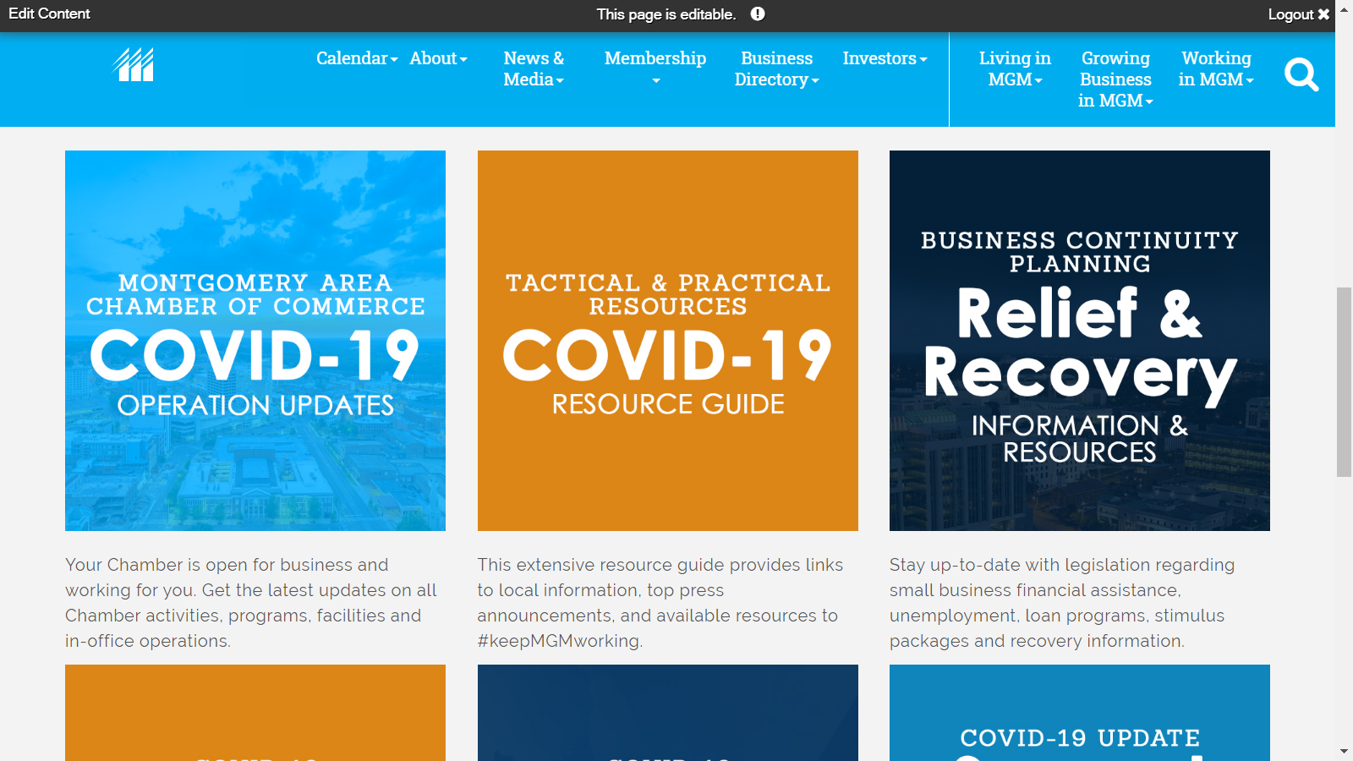
MGM COVID-19 WEBSITE

Slide 23


Slide 24
Small Business Administration Contact Information
Alabama SBA District Office
2 North 20th Street Suite #325
Birmingham, AL 35203
Phone: 205-290-7101
Fax: 205-731-0170
Website: https://www.sba.gov/offices/district/al/birmingham

Slide 25
Alabama Small Business Development Center Network
1-877-825-7232 Hotline
Website: Asbdc.org
Email: cap@asbdc.org

Slide 26
Birmingham Business Alliance Contact Information
505 20th Street N
Suite 200
Birmingham, AL 35203
Phone: (205) 324-2100
Website: Birminghambusinessalliance.com

Slide 27
Montgomery Area Chamber of Commerce Contact Information
600 S. Court St
Montgomery, Alabama 36101
http://www.facebook.com/montgomery.chamber
Twitter: http://www.twitter.com/mgmchamber
https://www.instagram.com/montgomery_chamber/

Slide 28

Congresswoman
Terri A. Sewell
Resource information will be available at
Sewell.house.gov

